Slide 1

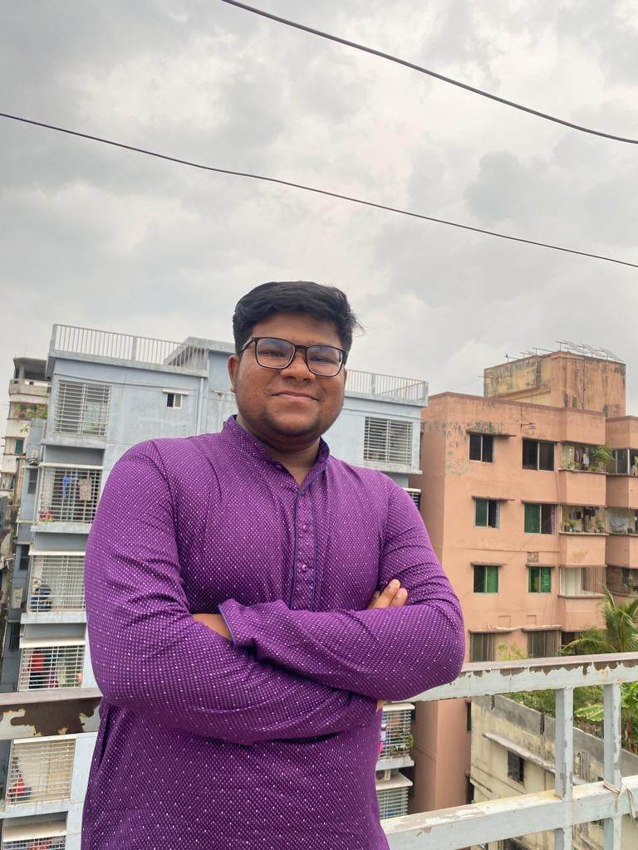

Title:- BulliSheild: “A Complete System to Detect, Stop Cyber Bullying Along with AI supported Mental Health Counselling ChatBot"
Farhana Akbar
Farhan Tahmid
Nafiur Rahman
Our Team
ID: 2012482042
ID: 2031458642
ID: 2014154642

Slide 2
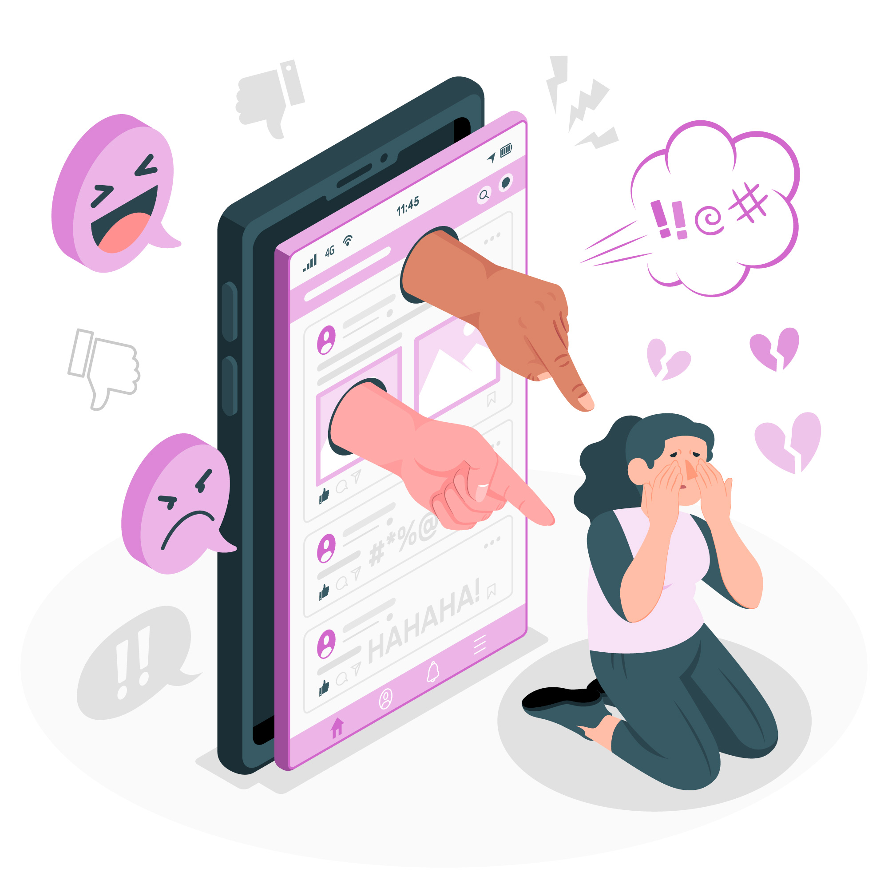
Introduction
A complete system that can stop cyberbullying. This system will be working with institutions and organizations to detect cyberbullying cases in different forms, keep records of the victims and bullies and take actions centrally if needed. Also the system can provide personalized counselling to victims.

Slide 3
Target / Audience
Institutions will be our main target. It could be
School
College
University

Slide 4


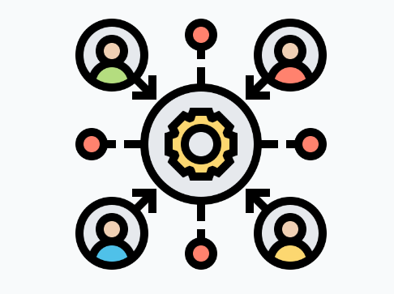

Need, Problem and Opportunity
Cyber bullying increasing
day by day
Getting out of control these days!
There should be a centralized system with stored records
Institutions can use it easily.

Slide 5





User- Admin Functionalities
Registration
First they have to signup then they will login.
Edit Profile Information
Proper Updated Profile (name, id, picture, number, address, parent’s number).
File a Complain / Check a posted complain
With bully’s details & complain details.
Submit Valid Information/ Justify Guilty or not Guilty
Proper images related to the incident.
Get Consultation from AIChatBot
Can talk we chatbot whenever they need.

